Slide 1



Power BI & Synapse – The Art of (im)possible!
Nikola Ilic
SQL Saturday LA 2021-06-12
@DataMozart

Slide 2





Nikola Ilic
BI Developer @ITSP Services GmbH
Data-mozart.com
@DataMozart
I'm making music from the data!
Power BI and SQL Server addict, MCT, blogger, speaker...
Father of 2, Barca & Leo Messi fan...

Slide 3







Contents at a glance
Traditional vs Modern data warehousing
What is Azure Synapse Analytics ?
Serverless SQL Pool – What, When, Why?
T-SQL – what is (im)possible?
DOs & DON‘Ts of Serverless SQL Pool
Show me the $$$ - how much will it cost me?
Demo
@DataMozart

Slide 4

Prerequisite
@DataMozart

Slide 5
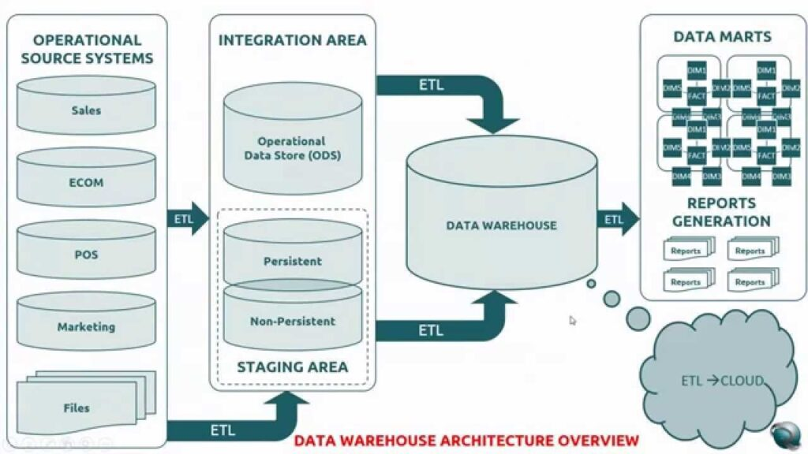
Traditional vs Modern data warehousing
@DataMozart

Slide 6

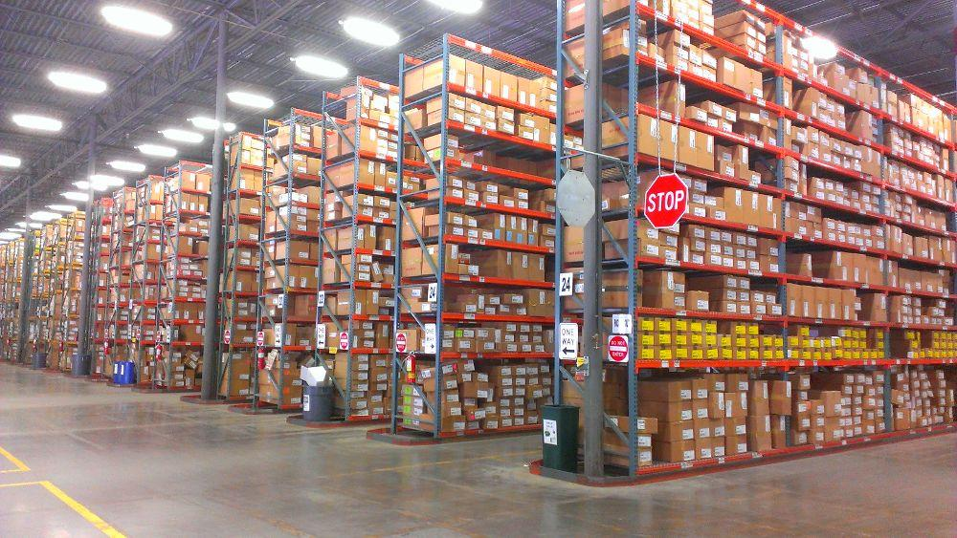
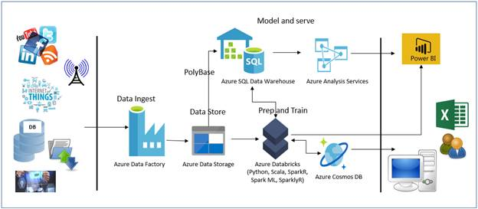
Traditional vs Modern data warehousing
Scalability
Flexibility
Cost-efficiency
@DataMozart

Slide 7

What is Synapse Analytics?
End-to-End Analytics Solution
@DataMozart

Slide 8
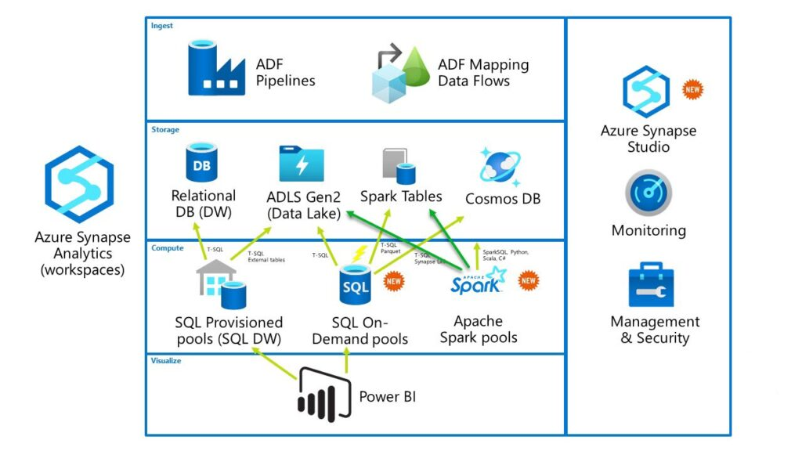
What is Synapse Analytics?
SQL
Apache Spark
ADLS2
Pipelines
Power BI
@DataMozart

Slide 9
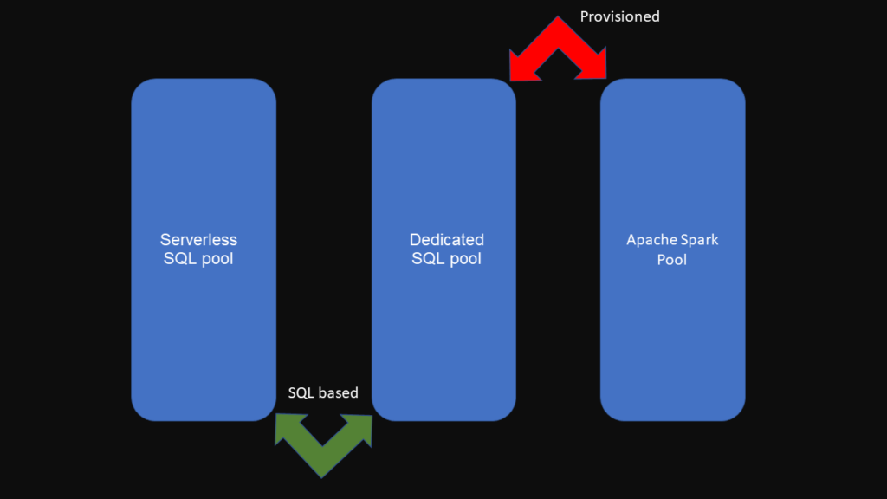
Synapse Analytics Pools
2 SQL-based
2 Provisioned
@DataMozart

Slide 10
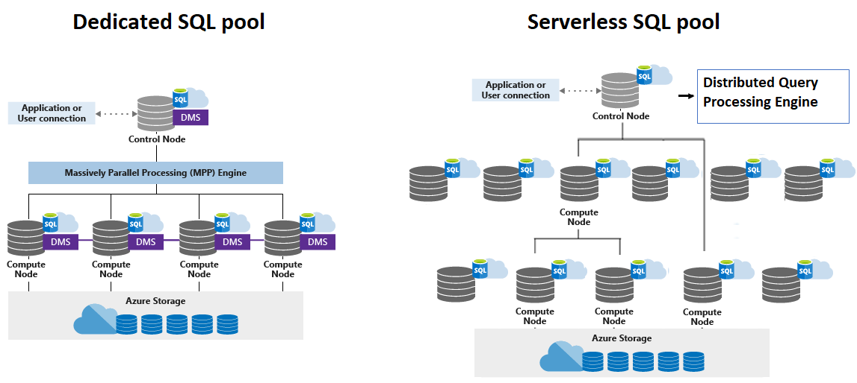
Serverless SQL Pool
Distributed Query Processing (DQP)
Query = Task
Scaling is done automatically != Dedicated SQL Pool!
@DataMozart

Slide 11
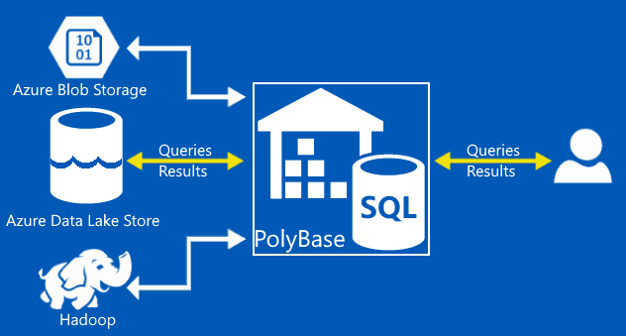

Serverless SQL Pool – What?
Distributed data processing system
Query files in your Azure storage accounts (ADLS Gen2)
Pay-per-query!
Polybase on steroids!
@DataMozart

Slide 12

Serverless SQL Pool – Why?
No need to setup infrastructure – reduces Time-To-Analysis
No charge for resources
Well known T-SQL syntax to query data
@DataMozart

Slide 13

Serverless SQL Pool – When?
Quick insight into ADLS data
Logical Data Warehouse
Simple & Scalable data transformation/data preparation
@DataMozart

Slide 14
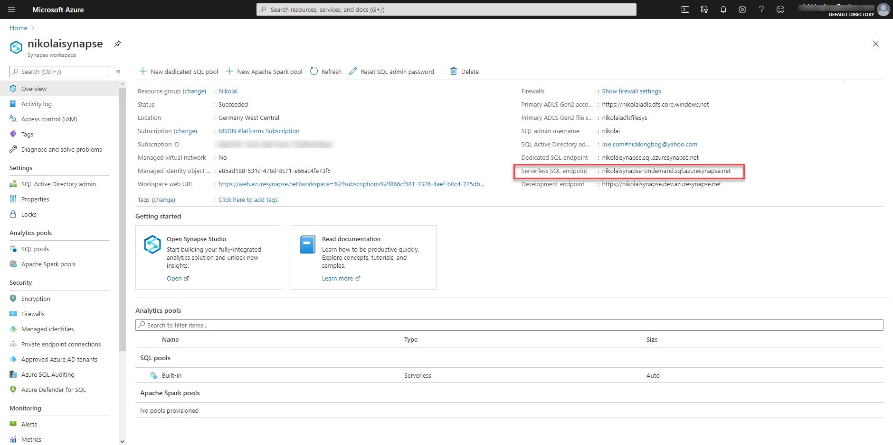
Serverless SQL Pool – How do I access it?
Serverless SQL Endpoint
Synapse Studio + “Usual suspects” SSMS & ADS
Demo
@DataMozart

Slide 15


T-SQL – What is (im)possible?
Database objects
Views
Schemas
Stored procedures
Inline TVFs
External tables
Statistics
Tables – both permanent and temp
Query caching
Materialized views
Indexes
Table Partitions
@DataMozart

Slide 16
T-SQL – What is (im)possible?
SELECT
Transactions (on meta-data objects)
Data export (CETAS)
Cross-database queries
Built-in functions (except OPENXML, OPENDATASOURCE and OPENQUERY)
DDL statements
T-SQL
INSERT, UPDATE, DELETE...
MERGE
Within SELECT – FOR XML, MATCH, PREDICT, query hints…
Combining system views with distributed data
@DataMozart

Slide 17


DOs & DON’Ts
Avoid latency with Geo location!
Transform CSV/JSON to Parquet
Handle inferred data types
Reduce data scanning and processing with FILENAME and FILEPATH
Use CETAS whenever possible
Carefully plan workloads during the query execution!
Avoid schema inference
Get rid of single large files
@DataMozart

Slide 18

How much will it cost me???
@DataMozart

Slide 19
How much will it cost me???
What I’m paying for?
Data processed
Data read amount
Data itself
Metadata
Data moved amount
Data written amount
1 TB of Processed Data ~ 5$+ (depending on region)
Min chargeable amount per query = 10 MB
Statistics
CSV vs Parquet!
@DataMozart

Slide 20
How much will it cost me???
What I’m NOT paying for?
!= Data processed
Server-level metadata
Databases
Metadata related queries
DDL statements (except CREATE STATISTICS)
@DataMozart

Slide 21

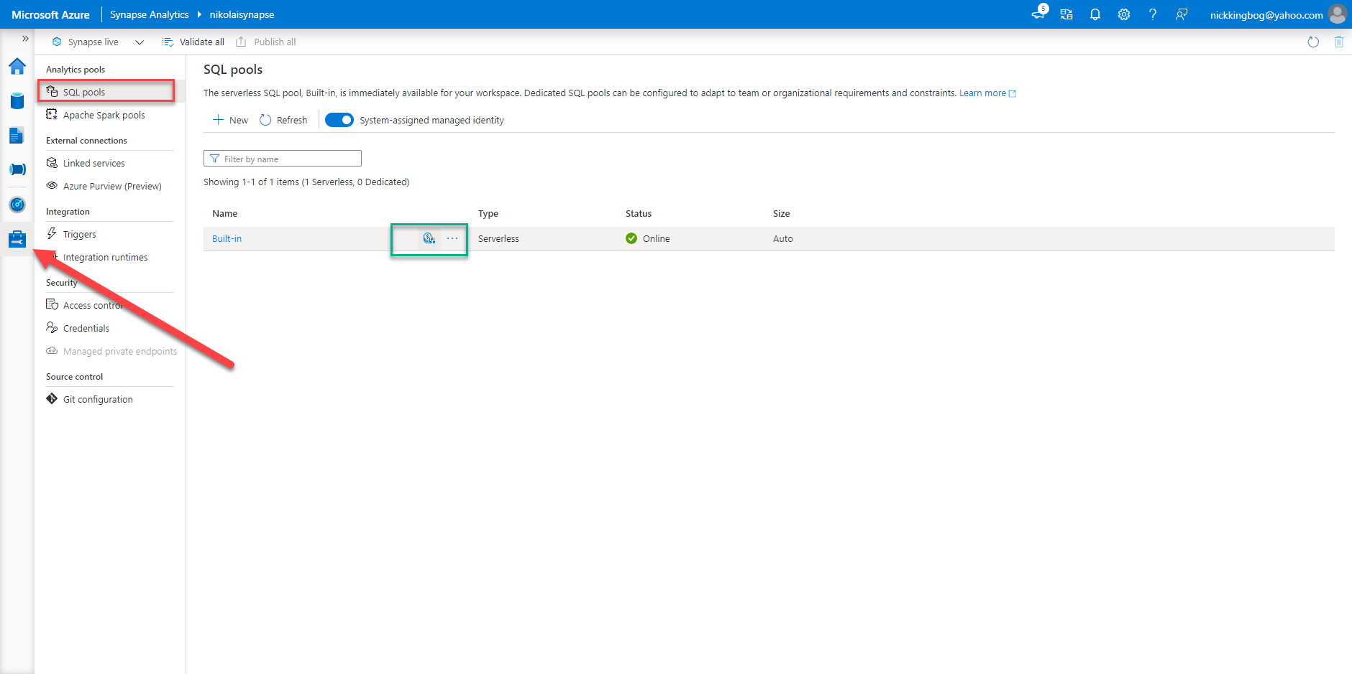
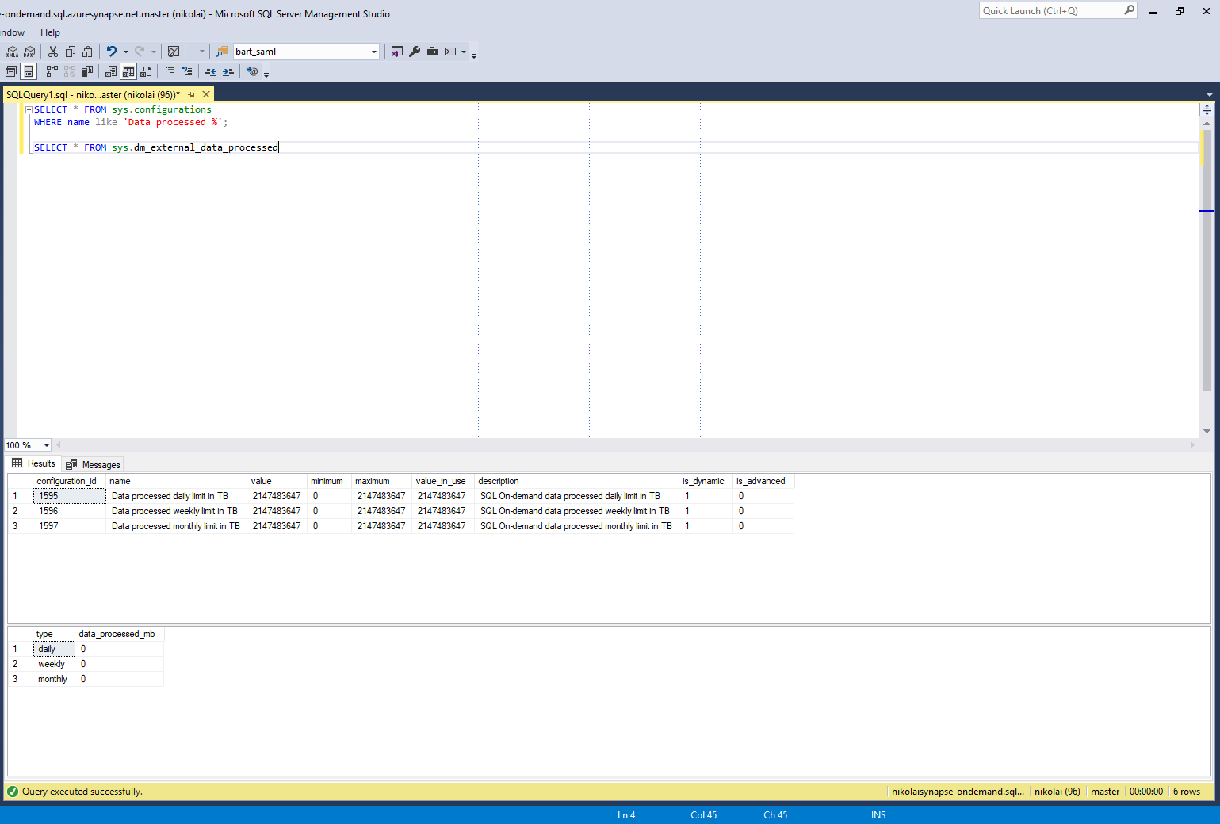
Cost Control
TBs per Day / Week / Month
UI Synapse Studio
T-SQL statements in SSMS/ADS
@DataMozart

Slide 22

Power BI & Serverless SQL
Yellow Cab dataset
2 CSV files – 655 MB & 620 MB
2 Parquet files – 256 MB & 243 MB
File 1 has ~ 7.6 million records, File 2 has ~ 7 million records
Measure costs only!
Scenario
@DataMozart

Slide 23
Power BI & Serverless SQL
CSV
PARQUET
Use Case | Costs $ | Remark
Import CSV in Power BI (2 visuals) | ~0.018 per refresh | Number of visuals and number of users don’t affect costs
DirectQuery over CSV files (2 visuals/1 user) | ~0.02 per 2 visuals/1 user | Number of visuals and number of users running report affect costs
Aggregated table in DirectQuery mode (CSV) | ~0.02 per 2 visuals/1 user | Number of visuals and number of users running report affect costs
Aggregated table in Import mode (CSV) | ~0.018 per refresh | Number of visuals and number of users don’t affect costs
Aggregated data in Serverless SQL pool in Synapse (CSV) | ~0.02 per 2 visuals/1 user | Streamed data amount is lower – makes the difference in larger datasets!
Use Case | Costs $ | Remark
Import Parquet files in Power BI (2 visuals) | ~0.01 per refresh | Number of visuals and number of users don’t affect costs
DirectQuery over Parquet files | ~0.13 per 2 visuals/1 user with Date dim ** ~0.002 per 2 visuals/1 user without Date dim | Surprisingly high with Composite model (Date dim created using M and stored in Power BI)! Great results when Date dim was excluded
Aggregated data in Serverless SQL pool in Synapse (Parquet) | ~0.002 per 2 visuals/1 user | Magic!

Slide 24
Power BI & Serverless SQL
Conclusions
No matter what you do in Serverless SQL on top of CSV files, they will always be fully scanned
Whenever possible, use Parquet format instead of CSV
Whenever possible, use Import mode instead of DirectQuery
Parquet – create pre-aggregated data (views) in the Serverless SQL pool
No Result set cache!!!
High number of queries over large dataset – Dedicated SQL pool?
@DataMozart

Slide 25

Questions
@DataMozart

Slide 26

Thank you!
@DataMozart

